Slide 1

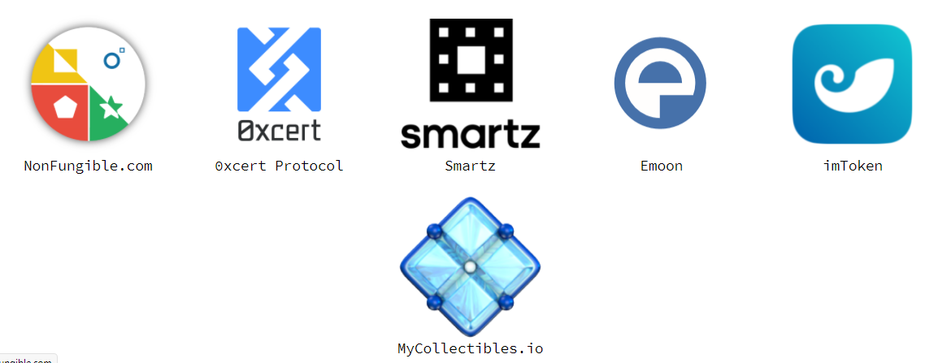
Non-fungible tokens (NFT)
Loke KS

Slide 2
Readings
https://www.coindesk.com/its-an-nft-boom-do-you-know-where-your-digital-art-lives

Slide 3
Introduction
A way to represent anything unique as an Ethereum-based asset.
NFT stands for non-fungible token. Non-fungible is an economic term that you could use to describe things like your furniture, a song file, or your computer. These things are not interchangeable for other items because they have unique properties.
Fungible items, on the other hand, can be exchanged because their value defines them rather than their unique properties. For example, ETH or dollars are fungible because 1 ETH / $1 USD is exchangeable for another 1 ETH / $1 USD.
Non-fungible tokens (NFT) | ethereum.org

Slide 4
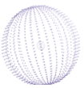

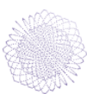
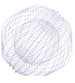

Introduction

Slide 5
Introduction
NFTs and Ethereum solve some of the problems that exist in the internet today.
As everything becomes more digital, there's a need to replicate the properties of physical items like
  scarcity
  Uniqueness
  proof of ownership
Without these properties you can’t resell digital assets.

Slide 6
Comparison
An NFT internet | The internet today
NFTs are digitally unique, no two NFTs are the same | A copy of a file, like an .mp3 or .jpg, is the same as the original.
Every NFT must have an owner and this is of public record and easy for anyone to verify | Ownership records of digital items are stored on servers controlled by institutions – you must take their word for it.
NFTs are compatible with anything built using Ethereum. An NFT ticket for an event can be traded on every Ethereum marketplace, for an entirely different NFT. You could trade a piece of art for a ticket! | Companies with digital items must build their own infrastructure. For example an app that issues digital tickets for events would have to build their own ticket exchange.
Creators can retain ownership rights over their own work, and claim resale royalties directly. | Platforms, such as music streaming services, retain the majority of profits from sales.

Slide 7
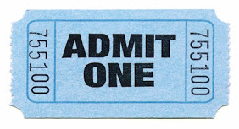
NFT examples
The NFT world is relatively new. In theory, the scope for NFTs is anything that is unique that needs provable ownership. Here are some examples of NFTs that exist today, to help you get the idea:
A unique digital artwork.
A unique sneaker in a limited-run fashion line.
An in-game item.
An essay.
A digital collectible.
A domain name.
my example for event ticket

Slide 8
Properties
NFTs have some special properties:
  Each token minted has a unique identifier.
  They're not directly interchangeable with other tokens 1:1.
    For example 1 ETH is exactly the same as another ETH. This isn't the case with NFTs.
  Each token has an owner and this information is easily verifiable.
  They live on Ethereum and can be bought and sold on any Ethereum-based NFT market.

Slide 9
Properties
In other words, if you own an NFT:
  You can easily prove you own it.
  No one can manipulate it in any way.
  You can sell it, and in some cases this will earn the original creator resale royalties.
  Or, you can hold it forever, resting comfortably knowing your asset is secured by your wallet on Ethereum.

Slide 10
Properties
And if you create an NFT:
  You can easily prove you're the creator.
  You determine the scarcity.
  You can earn royalties every time it's sold.
  You can sell it on any NFT market or peer-to-peer. You're not locked in to any platform and you don't need anyone to intermediate.

Slide 11
Counterfeiting
NFT contracts provides a standard for contracts that solve many of the problems that had become rampant with physical tokens.
For example, ticket counterfeiting is a major problem with the rise of improved printing technologies and lack of a common tracking software for all tickets.
NFT contracts eliminates this and other forms of counterfeiting because each item can be represented only once on the Ethereum network.
Scarcity can be verified by in real-time by anyone, even non-technical users, via blockchain explorers

Slide 12
Scarcity
The creator of an NFT gets to decide the scarcity of their asset.
For example, consider a ticket to a sporting event.
Sometimes these are exact replicas, such as 5000 General Admission tickets. Sometimes several are minted as a ticket with an assigned seat.
The creator may want to create an NFT where only one is minted as a special rare collectible. In these cases, each NFT would still have a unique identifier (like a bar code on a traditional "ticket"), with only one owner.
The intended scarcity of the NFT matters, and is up to the creator.
Non-fungible tokens (NFT) | ethereum.org

Slide 13
Royalties
Some NFTs will automatically pay out royalties to their creators when they're sold. This is still a developing concept but it's one of the most powerful.
  Example: Original owners of EulerBeats Originals earn an 8% royalty every time the NFT is sold.
  Some platforms, like Foundation and Zora, support royalties for their artists.
This is completely automatic so creators can just sit back and earn royalties as their work is sold from person to person.
NFTs solve an issue that the art world is facing with royalties and authenticity

Slide 14
Usage
The biggest use of NFTs today is in the digital content realm.
An artist publishing work on a social network makes money for the platform who sell ads to the artists followers. They get exposure in return, but exposure doesn't pay the bills.
NFTs power a new creator economy where creators don't hand ownership of their content over to the platforms they use to publicize it. Ownership is baked into the content itself.
When they sell their content, funds go directly to them. If the new owner then sells the NFT, the original creator can even automatically receive royalties. This is guaranteed every time it's sold because the creator's address is part of the token's metadata – metadata which can't be modified.

Slide 15
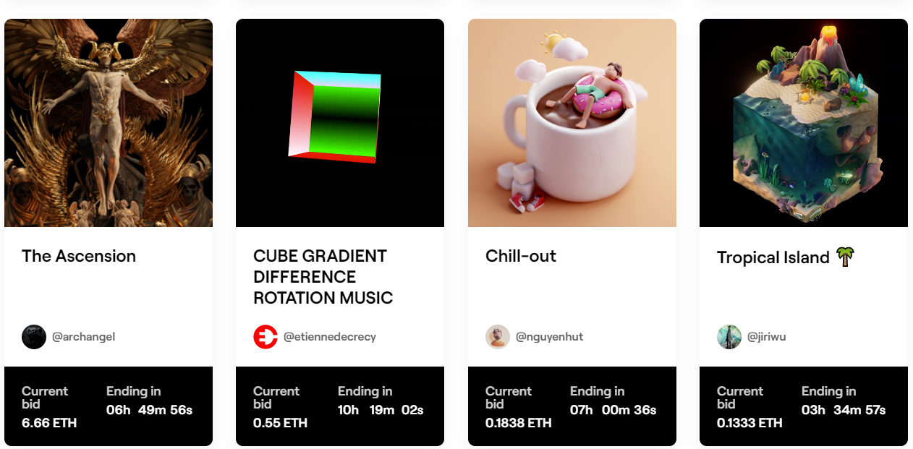
Usage
https://ethereum.org/en/dapps/?category=collectibles
Art: https://foundation.app/

Slide 16
Gaming potential
NFTs have seen a lot of interest from game developers. NFTs can provide records of ownership for in-game items, fuel in-game economies, and bring a host of benefits to the players.
In a lot of regular games you can buy items for you to use in your game. But if that item was an NFT you could recoup your money by selling it on when you're done with the game
For game developers – as issuers of the NFT – they could earn a royalty every time an item is re-sold in the open marketplace. This creates a more mutually-beneficial business model where both players and developers earn from the secondary NFT market.

Slide 17
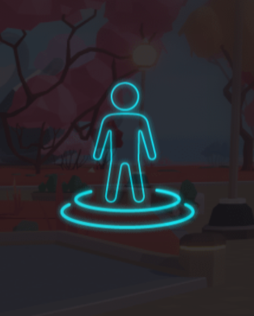
Decentraland
Decentraland, a virtual reality game, even lets you buy NFTs representing virtual parcels of land that you can use as you see fit.
Decentraland is a decentralized virtual reality platform powered by the Ethereum blockchain. Within the Decentraland platform, users can create, experience, and monetize their content and applications.
The finite, traversable, 3D virtual space within Decentraland is called LAND, a non-fungible digital asset maintained in an Ethereum smart contract. Land is divided into parcels that are identified by cartesian coordinates (x,y). These parcels are permanently owned by members of the community and are purchased using MANA, Decentraland’s cryptocurrency token.

Slide 18
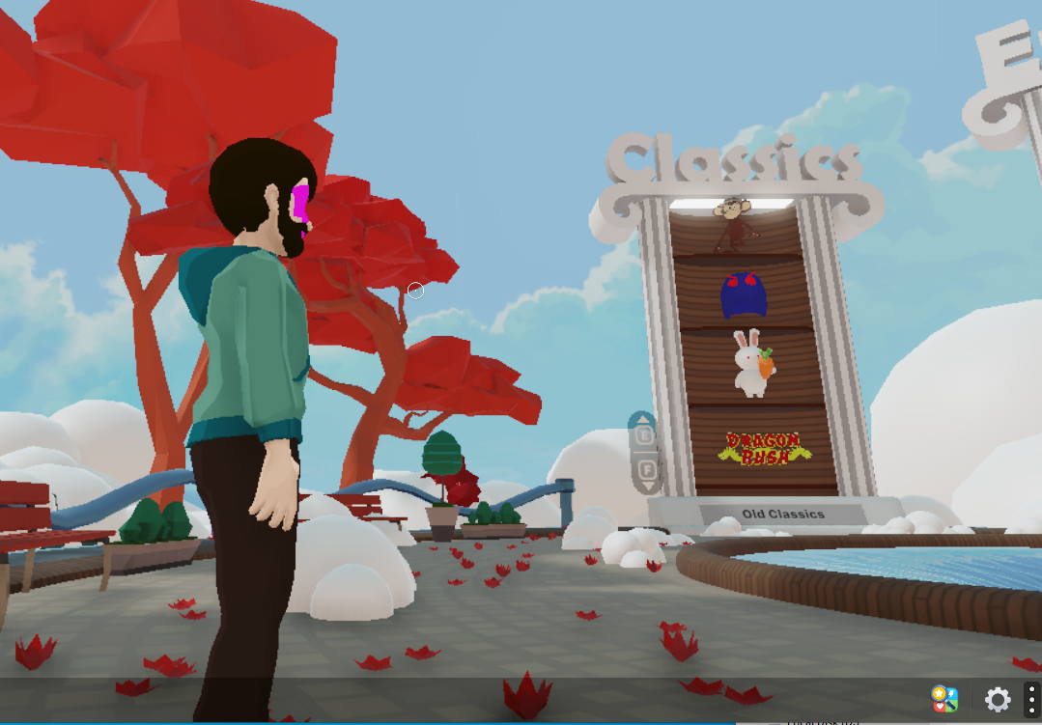
Decentraland

Slide 19
Ethereum Name Service
The Ethereum Name Service uses NFTs to provide your Ethereum address with an easier-to-remember name like mywallet.eth. This means you could ask someone to send you ETH via mywallet.eth rather than 0x123456789......
This works in a similar way to a website domain name which makes an IP address more memorable. And like domains, ENS names have value, usually based on length and relevance. With ENS you don't need a domain registry to facilitate the transfer of ownership. Instead, you can trade your ENS names on an NFT marketplace.
Your ENS name can:
  Receive cryptocurrency and other NFTs.
  Point to a decentralized website
  Store any arbitrary information, including profile information like email addresses and Twitter handles.
https://docs.ipfs.io/how-to/websites-on-ipfs/link-a-domain/#domain-name-service-dns

Slide 20
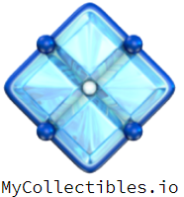
Physical items
The tokenisation of physical items isn't yet as developed as their digital counterparts. But there are plenty of projects exploring the tokenisation of real estate, one-of-a-kind fashion items, and more.
As NFTs are essentially deeds, one day you could buy a car or home using ETH and receive the deed as an NFT in return (in the same transaction). As things become increasingly high-tech, it's not hard to imagine a world where your Ethereum wallet becomes the key to your car or home – your door being unlocked by the cryptographic proof of ownership.
With valuable assets like cars and property representable on Ethereum, you can use NFTs as collateral in decentralized loans. This is particularly helpful if you're not cash or crypto-rich but own physical items of value.

Slide 21

NFTs and DeFi: NFT-backed loans
There are DeFi applications that let you borrow money by using collateral. For example you collateralise 10 ETH so you can borrow 5000 DAI (a stablecoin). This guarantees that the lender gets paid back – if the borrower doesn't pay back the DAI, the collateral is sent to the lender. However not everyone has enough crypto to use as collateral.
Projects are beginning to explore using NFTs as collateral instead. Imagine you bought a rare CryptoPunk NFT back in the day – they can fetch $1000s at today's prices. By putting this up as collateral, you can access a loan with the same rule set. If you don't pay back the DAI, your CryptoPunk will be sent to the lender as collateral. This could eventually work with anything you tokenise as an NFT.

Slide 22
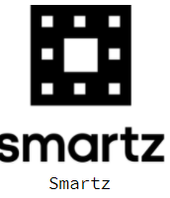
NFTs and DeFi: Fractional ownership
NFT creators can also create "shares" for their NFT. This gives investors and fans the opportunity to own a part of an NFT without having to buy the whole thing. This adds even more opportunities for NFT minters and collectors alike.
Fractionalised NFTs can be traded on DEXs like Uniswap, not just NFT marketplaces. That means more buyers and sellers.
An NFT's overall price can be defined by the price of its fractions.
You have more of an opportunity to own and profit from items you care about. It's harder to be priced out of owning NFTs.

Slide 23
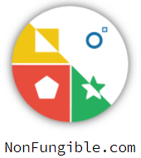
NFTs and DeFi: Fractional ownership
You would become a shareholder in a Picasso NFT, meaning you would have a say in things like revenue sharing. It's very likely that one day soon owning a fraction of an NFT will enter you into a decentralised autonomous organisation (DAO) for managing that asset.
These are Ethereum-powered organisations that allow strangers, like global shareholders of an asset, to coordinate securely without necessarily having to trust the other people. That's because not a single penny can be spent without group approval.

Slide 24
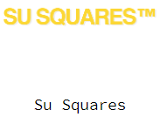
Ethereum and NFTs
Ethereum makes it possible for NFTs to work for a number of reasons:
Transaction history and token metadata is publicly verifiable – it's simple to prove ownership history.
Once a transaction is confirmed, it's nearly impossible to manipulate that data to "steal" ownership.
Trading NFTs can happen peer-to-peer without needing platforms that can take large cuts as compensation.
You can buy an NFT on one product and sell it on another easily. As a creator you can list your NFTs on multiple products at the same time – every product will have the most up-to-date ownership information.
Ethereum never goes down, meaning your tokens will always be available to sell.

Slide 25

Minting your NFT
When you mint an NFT, a few things have to happen:
It needs to be confirmed as an asset on the blockchain.
The owner's account balance must be updated to include that asset. This makes it possible for it to then be traded or verifiably "owned".
The transactions that confirm the above need to be added to a block and "immortalised" on the chain.
The block needs to be confirmed by everyone in the network as "correct". This consensus removes the need for intermediaries because the network agrees that your NFT exists and belongs to you. And it's on chain so anyone can check it. This is one of the ways Ethereum helps NFT creators to maximise their earnings

Slide 26
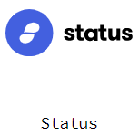
Creating NFTs
Most NFTs are built using a consistent standard known as ERC-721.
However there are other standards that you might want to look into.
The ERC-1155 standard allows for semi-fungible tokens which is particularly useful in the realm of gaming.
And more recently, EIP-2309 has been proposed to make minting NFTs a lot more efficient. This standard lets you mint as many as you like in one transaction!

Slide 27
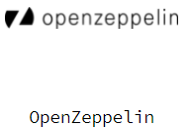
Creating NFTs
As ERC20 (fungible) tokens, NFT (non-fungible tokens) are also simple “databases” on the blockchain.
NFTs start with the ERC721 token standard, which has a similar syntax to that of ERC20
While an ERC20 token contract stores balances of Ethereum addresses, the NFT contract stores unique ID -> Ethereum address assignments. When you mint an NFT to yourself, the token contract assigns the unique token ID to your Ethereum address.
Transferring of ownership is an assignment of the ID (by a URI) that represents the thing behind the NFT (ex.: an image, a tweet, etc.).

Slide 28
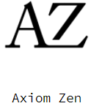
Creating NFTs
NFTs have a tokenURI variable which stores a distinct Uniform Resource Identifier (URI) for a given asset. For the tokenURI, one of the most popular approaches is using IPFS to store your data.
NFTs have a mapping of a tokenId to its owner, where each token has its own “owner.”
This differentiates them from the ERC20s, which only have a mapping of an address to a balance.
ERC721s still let people transfer the tokens, set permissions on the tokens, and more.

Slide 29
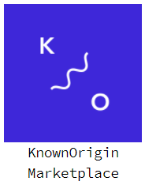
ERC721
ERC-721 defines some functions with compliance to ERC-20. This makes it easier for existing wallets to display simple token information.
ERC20-like Functions:
name: Used to define the token’s name, which other contracts and applications can identify.
symbol: Used to define token’s shorthand name or symbol.
totalSupply: This function is used to define the total number of tokens on the blockchain; the supply doesn’t have to be constant.
balanceOf: Returns number of NFTs owned by an address.
http://erc721.org/
EIP-721: ERC-721 Non-Fungible Token Standard (ethereum.org)

Slide 30
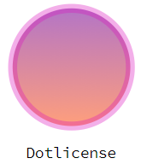
ERC721: Ownership Functions
ownerOf: This function returns the address of the owner of a token. As each ERC-721 token is unique and non-fungible, they are represented on the blockchain by an ID. Other users, contracts, apps can use this ID to determine the owner of the token.
safeTransferFrom: Transfers the ownership of an NFT from one address to another address. Throws unless `msg.sender` is the current owner
transferFrom: Transfer ownership of an NFT

Slide 31
ERC721: Transfers
Transfers may be initiated by:
  The owner of an NFT
  The approved address of an NFT
  An authorized operator of the current owner of an NFT
An authorized operator may set the approved address for an NFT. This provides a powerful set of tools for wallet, broker and auction applications to quickly use a large number of NFTs.

Slide 32
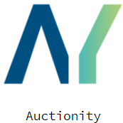
ERC721: Approval Functions
approve: This function grants or approves another entity the permission to transfer tokens on the owner’s behalf.
getApproved: Get the approved address for a single NFT.
isApprovedForAll: Query if an address is an authorized operator for another address
setApprovalForAll: Enable or disable approval for a third party ("operator") to manage all of `msg.sender`'s assets
The approval functions allow someone to approve another address for either one specific token or all tokens. Once you approve another address, it has full transfer control over it.

Slide 33
ERC721: Approval Functions
approve(address _to, uint256 tokenId) : By calling this method, the sender authorizes the address _to to transfer one of his tokens with the Id tokenId.
setApprovalForAll(address _to, bool approved) : By calling this method, the sender authorizes the address to to transfer all his tokens. _to is then called an operator of the sender.
In these two functions, _to can be either a smart contract or an EOA.
Only the NFT owner or an operator of the owner can call this approve function. It is used when the owner needs another user/contract to transfer his tokens on his behalf.

Slide 34
ERC721: Approval Functions
In the transferFrom() function, it requires the from parameter to be the token owner which earlier called the approve function.
An approved operator (in the previous ERC20 slides we used the term spender) would call this function and would be able to transfer tokens on behalf of the token owner.

Slide 35
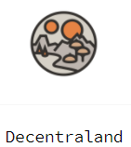
ERC721: Events
Transfer: This event is fired when the ownership of the token changes from one individual to another. It emits the information on which account transferred the token, which account received the token, and which token (by ID) was transferred.
Approval: This event is fired when a user approves another user to take ownership of the token, i.e., it is fired whenever approve function is executed. It emits the information on which account currently owns the token, which account is approved to take ownership of the token in the future, and which token (by ID) is approved to have its ownership transferred.

Slide 36
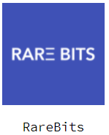
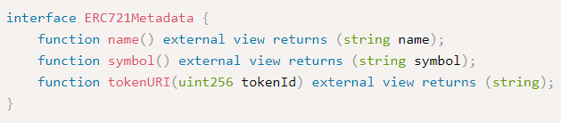
ERC721: Metadata (optional)
name and symbol functions in the metadata extension
A mechanism is provided to associate NFTs with URIs. We expect that many implementations will take advantage of this to provide metadata for each NFT.
This tokenURI links to a metadata file.

Slide 37

ERC721: Identifiers
Every NFT is identified by a unique uint256 ID inside the ERC-721 smart contract.
This identifying number SHALL NOT change for the life of the contract.
The pair (contract address, uint256 tokenId) will then be a globally unique and fully-qualified identifier for a specific asset on an Ethereum chain.
While some ERC-721 smart contracts may find it convenient to start with ID 0 and simply increment by one for each new NFT, callers SHALL NOT assume that ID numbers have any specific pattern to them, and MUST treat the ID as a “black box”.

Slide 38
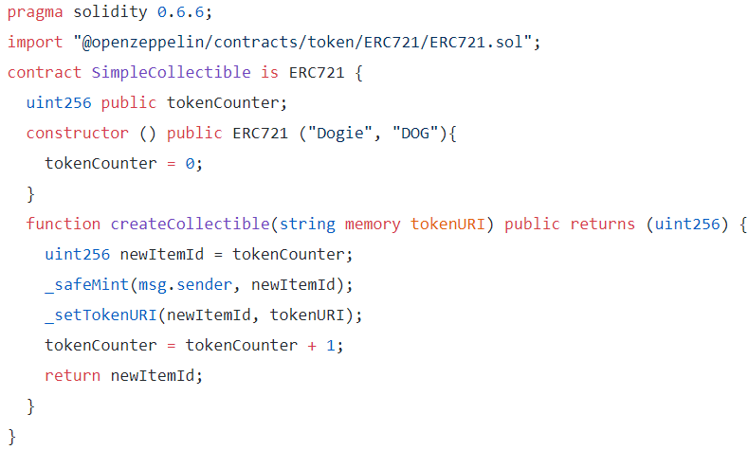
Simple contract
https://betterprogramming.pub/how-to-create-nfts-with-solidity-4fa1398eb70a

Slide 39

IPFS: InterPlanetary File System
Each NFT has a unique id that distinguishes it from all other tokens and optional property to link data that is stored outside of a smart contract.
Storing or processing data outside of a smart-contract is known as being off-chain because on-chain storage is expensive and not practical.
When a NFT is minted, a link to the digital asset can be made. HTTP links are not a good idea:
  The server could be unhosted
  The content at the link can be changed

Slide 40
IPFS: InterPlanetary File System
IPFS solves this problem thanks to Content Addressing.
Adding data to IPFS produces a content identifier (CID) that's directly derived from the data itself and links to the data in the IPFS network.
Basically it hashes the data and use the hash as an address.
Because a CID can only ever refer to one piece of content, we know that nobody can replace or alter the content without breaking the link.

Slide 41
IPFS: InterPlanetary File System
Using the CID, anyone can fetch a copy of the data from the IPFS network as long as at least one copy exists on the network, even if the original provider has disappeared.
This makes CIDs perfect for NFT storage. All we need to do is put the CID into an ipfs:// URI like
  ipfs://bafybeidlkqhddsjrdue7y3dy27pu5d7ydyemcls4z24szlyik3we7vqvam/nft-image.png
It creates an immutable link to the data for the token.
To make the data highly available without needing to run a local IPFS daemon 24/7, you can request that a remote pinning service store a copy of your IPFS data on their IPFS nodes.
https://nft.storage/ is another option that runs on top of IPFS

Slide 42
Problems with art and NFTs
Their apparent flaws in the way the system was set up.
It is possible to create more than one NFT for the same work of art. This creates separate chains of ownership for the same work of art.
If no NFT exists for a certain work of art, creating one does not require you to be the owner. This creates false chains of ownership.
The references defining the original depend too heavily on URLs that are vulnerable and could vanish at some point.
NFTs explained: daylight robbery on the blockchain - Malwarebytes Labs | Malwarebytes Labs

